Slide 1
Customer segmentation analysis for Nigerian e-commerce
Data-driven customer insights for targeted marketing & product recommendations
2023-B071-21285
TURYA JOHN STEVEN
13th DECEMBER 2025

Slide 2
Project overview
Objective: Perform customer segmentation to improve marketing targeting and product recommendations.
Methodology:
  Preprocessing: Data cleaning, mode imputation, and normalization.
  RFM Analysis: Aggregated data by recency, frequency and monetary value.
  Feature Engineering: Created loyalty index and engagement scores.
  Modeling: Used K-Means Clustering and PCA for dimensionality reduction.
Key Outcome: Identified 2 distinct high-level customer segments (Standard vs. VIP/Wholesale).

Slide 3
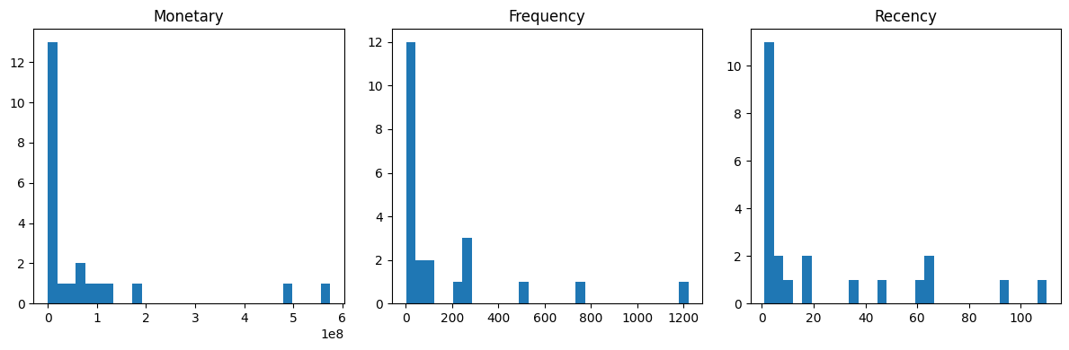
Exploratory Data Analysis - Distributions

Slide 4
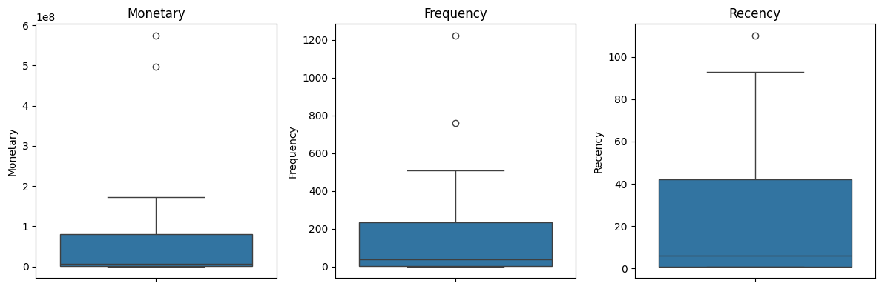
Outlier Analysis

Slide 5
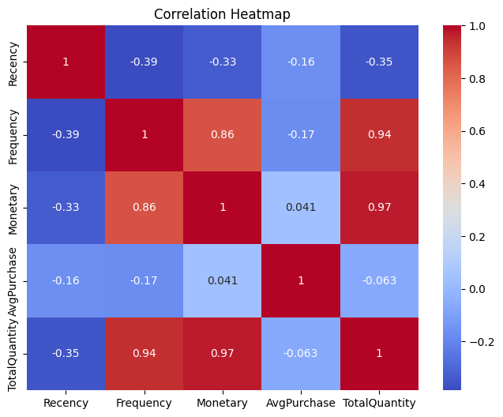
Feature Correlations

Slide 6
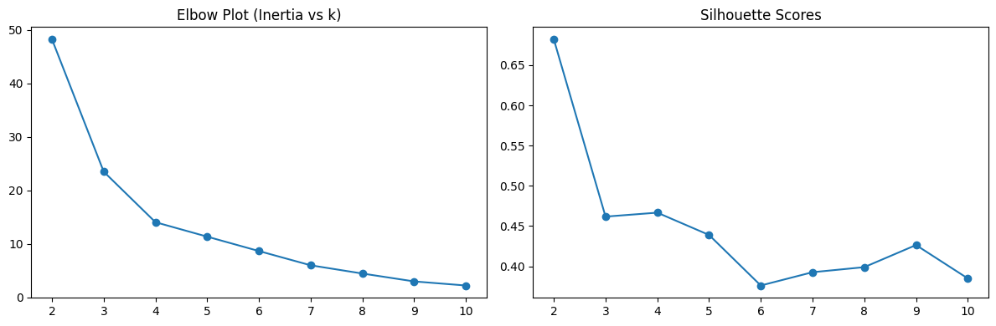
Determining Optimal Clusters
The Silhouette Score peaks at k=2.
This indicates the dataset splits most naturally into two main groups rather than many small micro-segments.

Slide 7
Cluster Visualization (PCA)
PCA reduced dimensions to 2 components for plotting.
Cluster 0 forms a dense group of standard users.
Cluster 1 represents extreme outliers (high-value VIPs).

Slide 8
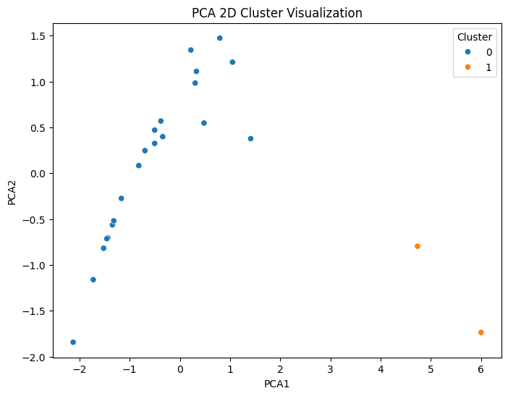
The 2D PCA Scatter Plot.

Slide 9
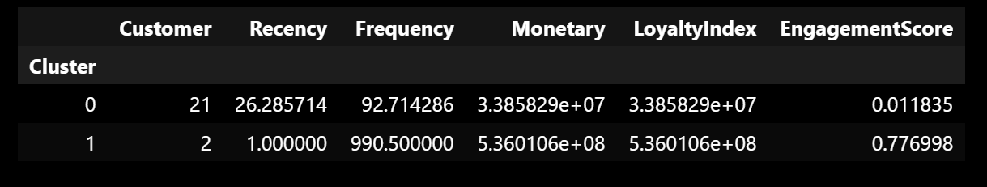
Summary of clusters

Slide 10
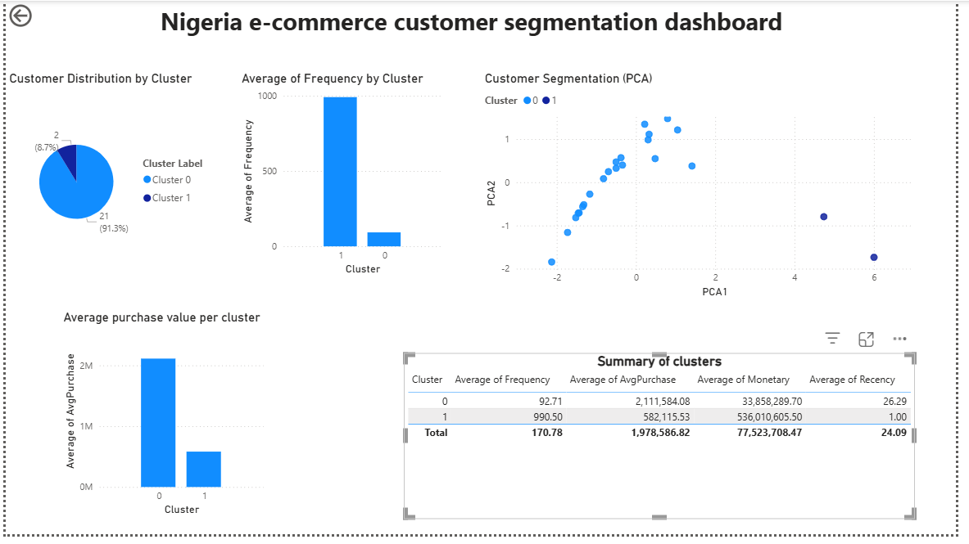
Dashboard

Slide 11
Conclusion
This project successfully applied data analytics and machine learning techniques to segment customers in a Nigerian e-commerce dataset.
Through data preprocessing, RFM analysis, feature engineering, and K-Means clustering, the study identified two distinct customer segments: standard customers and VIP/wholesale customers.
The findings demonstrate that customer segmentation can provide valuable insights into purchasing behavior, enabling businesses to implement targeted marketing strategies, improve customer retention, and enhance product recommendation systems.
Overall, this analysis highlights the importance of data-driven decision-making in e-commerce and shows how customer data can be transformed into actionable business insights.

